Slide 1
Overview of body systems that ensures homeostasis
Y.A. MENSAH-BONSU
MBCHB, MPH, MPHIL, WACS… GCPS…

Slide 2
Recommended Books
Review of Medical Physiology- Ganong
Textbook of Medical Physiology- Guyton & Hall
Physiology- Berne et al
Human Physiology- Sherwood
Human Physiology- Vander et al

Slide 3
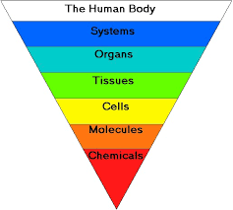
Levels of organization in the Human Body

Slide 4
Organ Systems
Notes:
This is also called hierarchy of life!

Slide 5
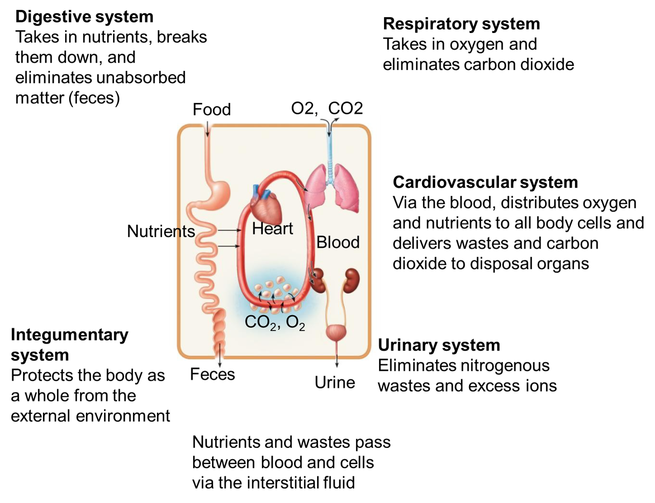
Organ Systems

Slide 6
Cardiovascular System G1a
DEFINITION
The heart and the vessels that carry blood or blood constituents (lymph) through the body.
FUNCTIONS
Transports respiratory gases,
nutrients, wastes, and hormones;
protects against disease and fluid
loss; helps regulate body temperature
and acid–base balance.
Notes:
These systems are grouped into 4 main Groups. Group 1 works in relation to the blood stream. Their function is to maintain homeostasis of the blood!

Slide 7
Respiratory System G1b
DEFINITION
The body organs concerned with movement of respiratory gases (O₂ and CO₂) to and from the pulmonary blood (the blood within the lungs).
FUNCTIONS
Supplies oxygen to the blood and
eliminates carbon dioxide;
also helps to regulate acid–base balance.
Pharynx is part of digestive and
respiratory system

Slide 8
Digestive System G1c
DEFINITION
The body organs that
render ingested foods absorbable.
FUNCTIONS
Mechanically and chemically breaks
down foods for cellular use and
eliminates undigested wastes.

Slide 9
Urinary System G1d
DEFINITION
The organs that operate to remove wastes from the blood and to
eliminate urine from the body.
FUNCTIONS
Removes various wastes from the blood; regulates the chemical composition, volume, and electrolyte balance of the blood; helps maintain the acid–base balance of the body.

Slide 10
Integumentary System G1e
DEFINITION:
The integument (skin) and structures derived from it (hair, nails, and oil sweat glands).
FUNCTIONS
Protects the body,
regulates body temperature,
eliminates wastes, and
receives certain stimuli (tactile,
temperature, and pain).

Slide 11
Lymphatic and Immune System G1f
DEFINITION
Consists of the lymphatic vessels, lymph nodes, and other lymphatic organs.
FUNCTIONS
Removes foreign substances from the blood and lymph, combats disease, maintains tissue fluid balance, and
absorbs dietary fats from the digestive tract.
Returns tissue fluids to the heart

Slide 12
Skeletal System G2a
DEFINITION
Bones, cartilage, and ligaments (which steady the bones at the joints).
FUNCTIONS
Provides body support and protection, permits movement and leverage, produces blood cells (hematopoiesis), and stores minerals.
Notes:
Muscle and skeletal systems function in external voluntary movement. Any injury to any of them leads to impairment in voluntary movement.

Slide 13
Muscular System G2b
DEFINITION
Skeletal muscles of the body and their tendinous attachments.
FUNCTIONS
Effects body movements, maintains
posture, and produces body heat.

Slide 14
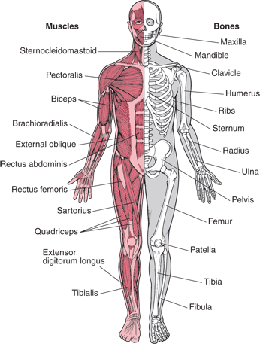
=Musculoskeletal System G2a-b

Slide 15
Reproductive Systems G3
DEFINITION
The body organs that produce, store, and transport reproductive
cells (gametes, or sperm and ova).
FUNCTIONS
Reproduce the organism, produce sex hormones.
Notes:
These systems are not essential for our day-to-day life. In fact, they do not function at all time. They are never like the other systems spoken about earlier.

Slide 16
Nervous System G4a
DEFINITION
Brain, spinal cord, nerves, and sensory organs such as the eye and the ear.
FUNCTIONS
Detects and responds to changes in
internal and external environments,
enables reasoning and memory, and
regulates body activities.
Notes:
Control of other systems

Slide 17
Endocrine System G4b
DEFINITION
The hormone producing glands.
•Hypothalamus
•Pineal gland
•Pituitary gland
•Thyroid
•Parathyroid
•Thymus
•Adrenal gland
•Pancreas
•Ovaries
•Testes
FUNCTIONS
Controls and integrates body
functions via hormones secreted
into the bloodstream.

Slide 18
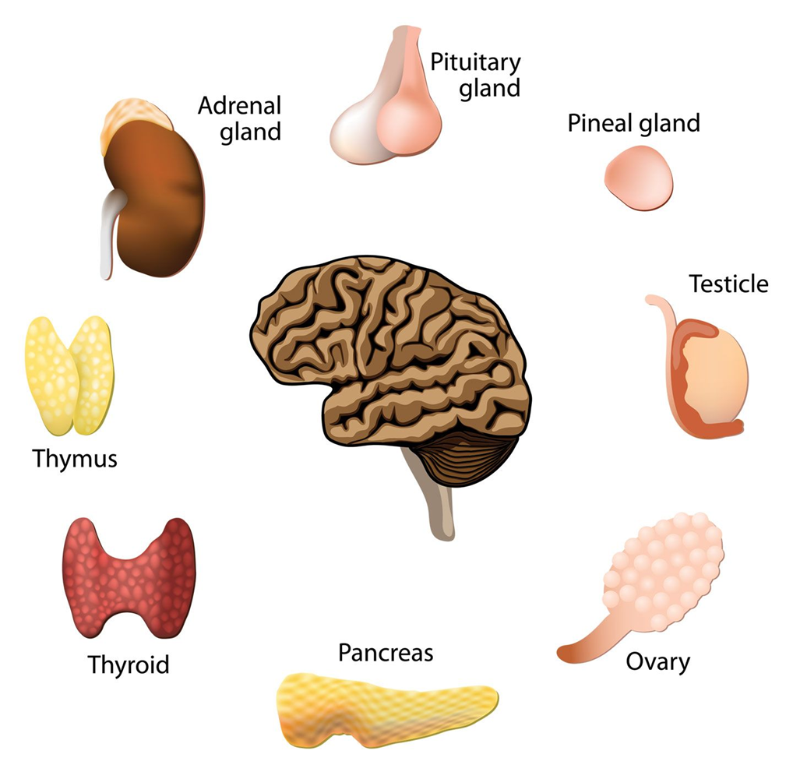
Neuro-endocrine System G4a-b

